Slide 1

Visual Management
QUICK
SET-UP

Slide 2


Visual Management
Module 1

Slide 3
Introduction
Welcome, to the Visual Management Workshop !
In this Opening Module we will discuss:
Goals and Objectives
Benefits of the Visual Management
4 Phases of the Visual Management

Slide 4
Visual Management Charter
Visual Management is promout as a workplace where all associates understand and manage their own work in a safe, clean, organized environment that fosters open communication, pride, and continuous improvement

Slide 5
Visual Management Goals
Make everyone’s job easier
Give all associates a high degree of ownership in their work, and pride in their workplace
Increase communication by making information easier to understand
Improve company overall success

Slide 6
Workshop Objectives
Understand the 4 Phases leading up to Visual Management of the Workplace
Apply the concepts and techniques for each phase through team exercises on the floor
Understand how to use Visual Management and the benefits it offers

Slide 7
Desired Outcome
Create a sense of “Who we are” and “What we do”
Employ company standards to make key processes universally understood
Make work decisions based on what we see
Communicate all ways
Make customer satisfaction visible

Slide 8

Brainstorming Exercise
Let’s think about things
as they are today. ..
Do we work in a visual
workplace ?

Slide 9

What is our current situation ?
How would you describe your current workplace situation?
Consider:
Personal Safety
Physical environment
The processes
Information access
Safety
W P O
Process
People
Data
Machines

Slide 10

Visual Workplace Vision
Describe your vision of what the ideal workplace is like

Slide 12
The Visual Workplace ...
is safe
is clean and organized
is easily understood
is managed through involvement by all
creates high quality products
communicates progress
generates pride

Slide 13

The Visual Management Assessment Test
In the visual workplace, anyone will easily know the:
who, what, when, where, why, and how of an area
within 5 minutes

Slide 14
The 4 Phases to Visual Management
Visual
Management
Visual Measures
Visual Display
Workplace Organization

Slide 15
Workplace Standards
Definition Objects or practices considered to be the example or model. Standards should be established by general team consensus.

Slide 16

Why use standards ?
Workplace standards offer
these benefits:
Universally understood
Assure quality and consistency
Eliminate variation
Make abnormalities apparent
ALTO

Slide 17
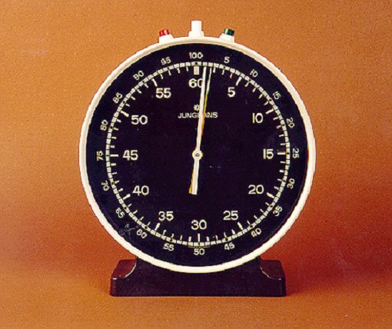
How many of these standards are standard in your plant ?
STANDARD
CHANGEOVER
CLOCK

Slide 18
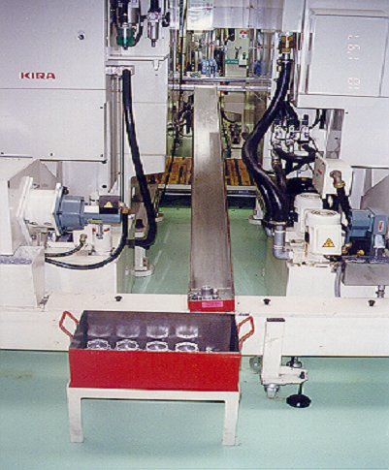
How many of these standards are standard in your plant ?
RED BOX SCRAP

Slide 19
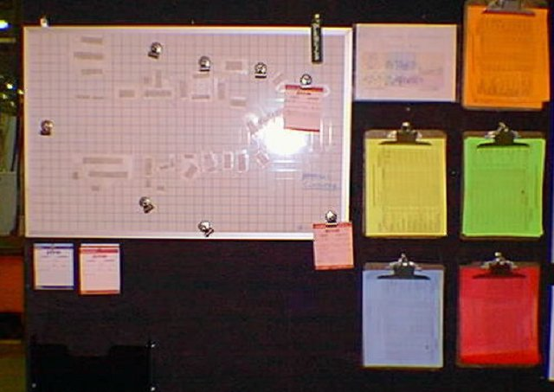
How many of these standards are standard in your plant ?
T P M
BOARD

Slide 20
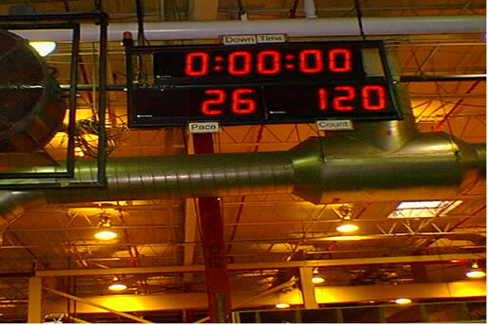
How many of these standards are standard in your plant ?
DOWNTIME / PRODUCTION DISPLAY

Slide 21
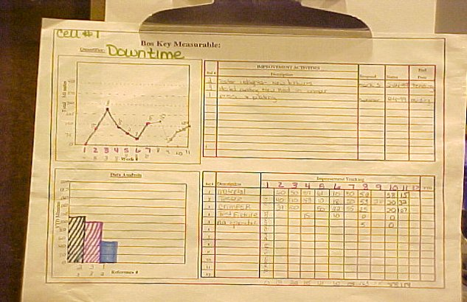
How many of these standards are standard in your plant ?
B O S CHART

Slide 22

Visual Management
Module 2

Slide 23
How do we create Visual Management?
One phase at a time...
The 1st Phase is
Workplace Organization

Slide 24
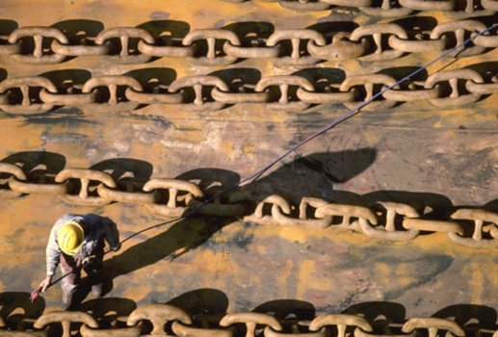
Workplace Organization
A Vital Link To Continuous Improvement

Slide 25
5S’S
S
S
S
Sort
Stabilize
Shine
Standardize
Sustain
S
S

Slide 26
Sort The First S

Slide 27
First S - Sort
Keep what is needed
Eliminate what is not
Identify what is out of place
X - Tag

Slide 28

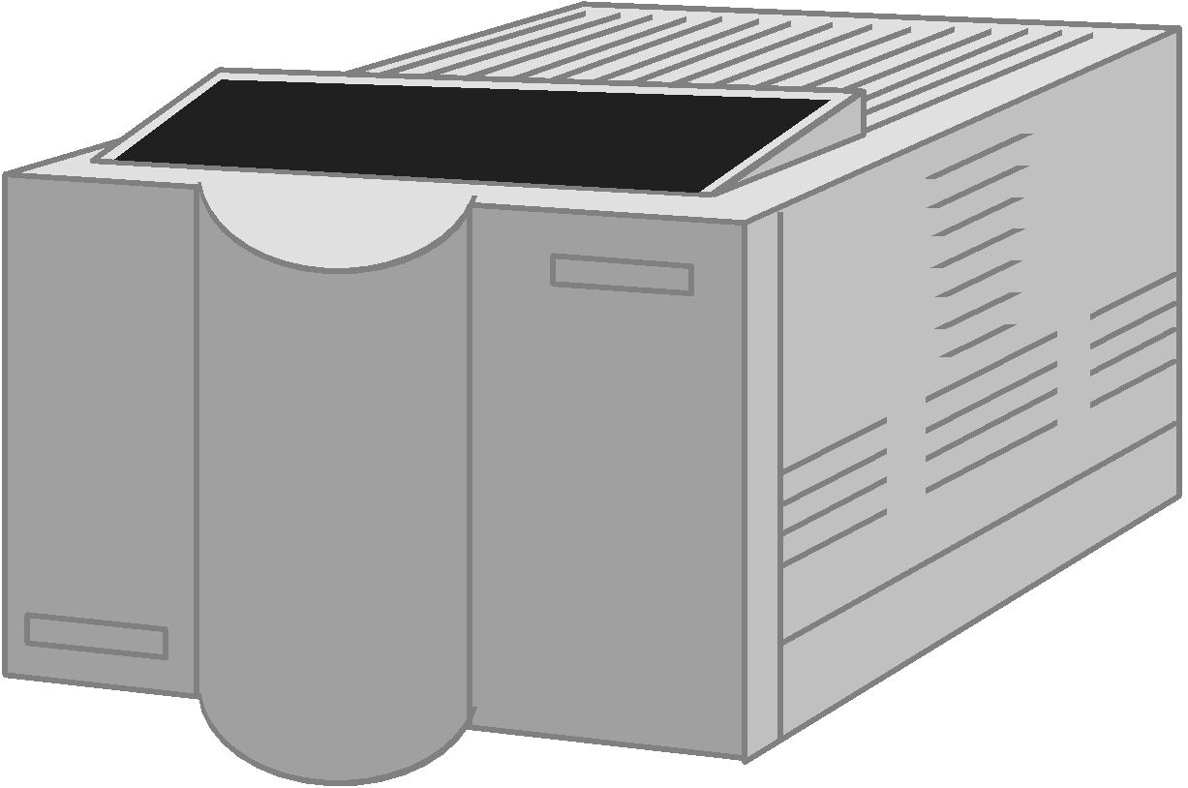
Dark Corners and Healing Walls

Slide 29
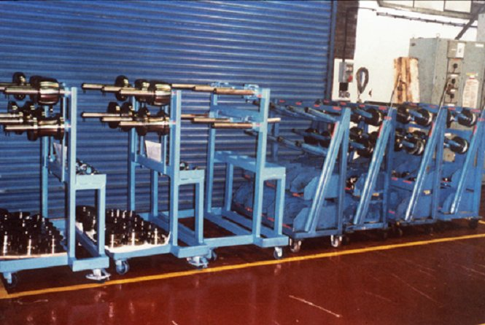
Sort Here Is A Good Example
How can it be improved?

Slide 30
X-Tag
Select a X-Tag leader
Identify what is not needed
Attach X-Tag
Move to holding area
Determine time to hold
Move to facility holding area
Tag all Safety problems
X-Tag

Slide 31
X-Tag Rule of Thumb
How often is it used?
What to do with it.
Never used
Once or twice a year
Once a month
Once a week
Once a day or more
Give, sell, or throw away
Store in a distant place
Store in the facility
Store in the area
Keep at the workplace or carry

Slide 32
X-Tag
Name:
Date: Removal Date
Location:
Reason for X-Tag:

Slide 33
Stabilize The Second S
Operator

Slide 34
2nd S - Stabilize
A place for everything and everything in its place
outlines
labels
shadow boxes
Designated responsibilities
color coded maps
X-Tag leaders
Make everything easy to find, use, and return

Slide 35
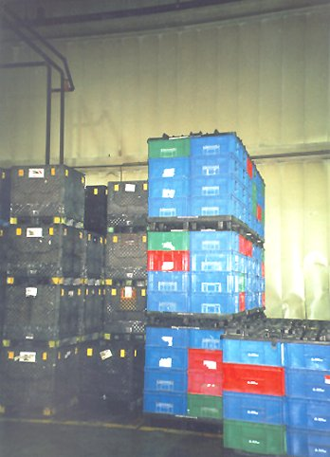
Does this look well stabilized?

Slide 36
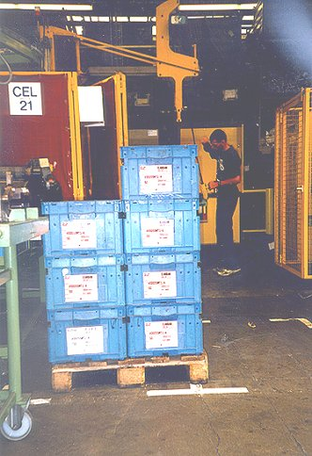
Outlines or Footprints
A little out of place

Slide 37
The Third S
Shine

Slide 38
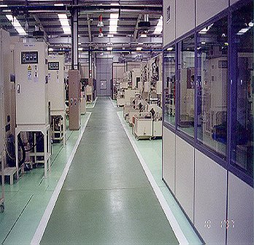
3rd S - Shine
Cleaning is inspection
Make cleaning everyday work
Assign responsibilities
color coded maps
rotate cleaning responsibilities
Utilize downtime & help others

Slide 39
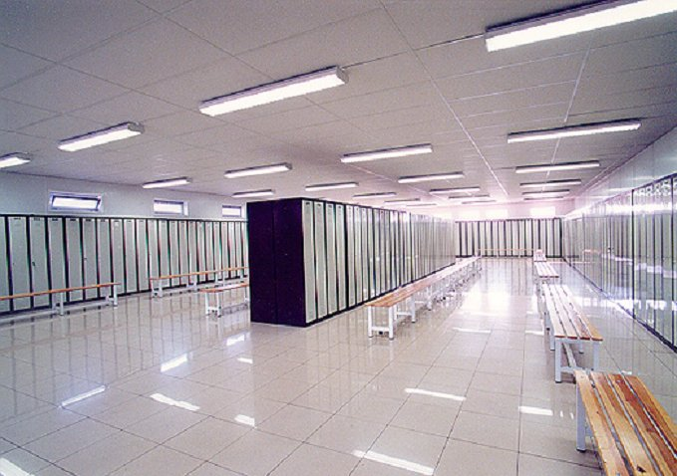
Is This Your Locker Room?

Slide 40
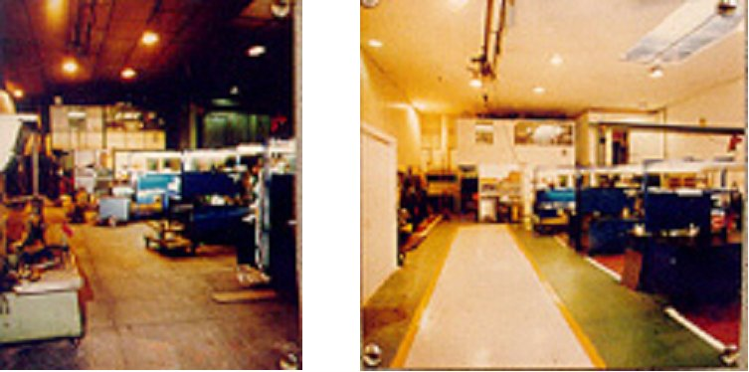
Before and After

Slide 41
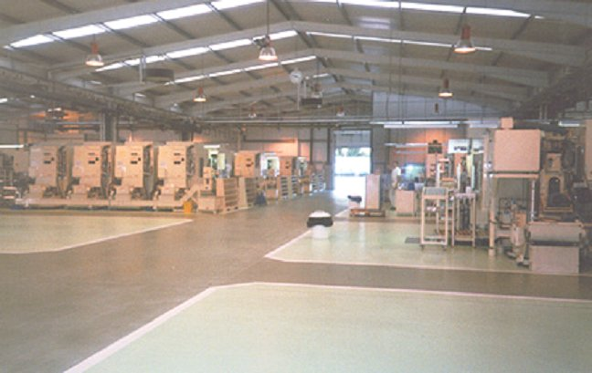
A well shined facility
Notes:
‹#›

Slide 42
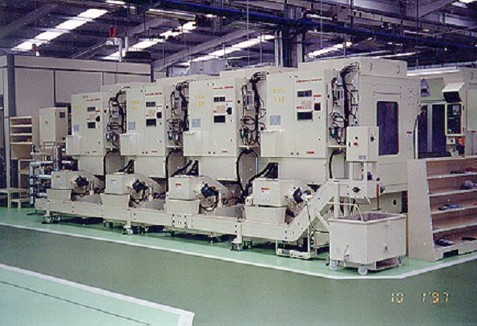
A well shined facility

Slide 43

Standardize The Fourth S

Slide 44
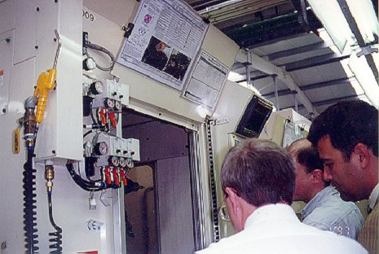
4th S - Standardize
X-Tag procedures
Holding areas
Cleaning procedures
Location of items
Operating procedures

Slide 45
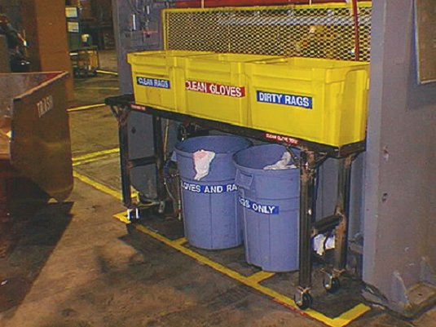
A Place For Everything
Even rags, gloves, and trash

Slide 46
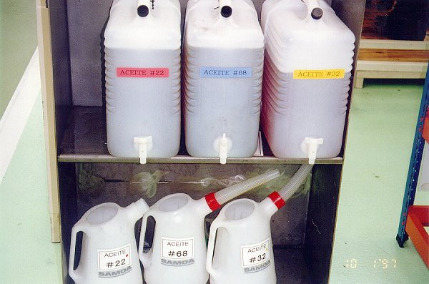
A Place For Everything
Every item has a place, is labeled, and color coded

Slide 47
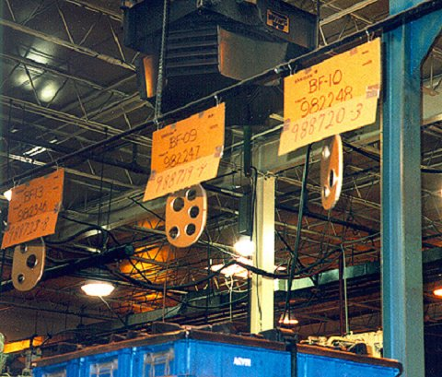
Communicating What Goes Where
Simple but effective

Slide 48
Sustain The Fifth S

Slide 49
5th S - Sustain
Make it a habit
It takes doing something 21 times before it becomes a habit
Proper training and communication
Inform all employees (especially new ones)
Support and cooperation from everyone

Slide 50
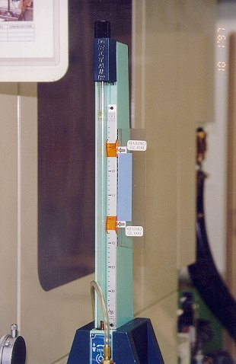
Visual Ranges Make It Easier to Sustain

Slide 51
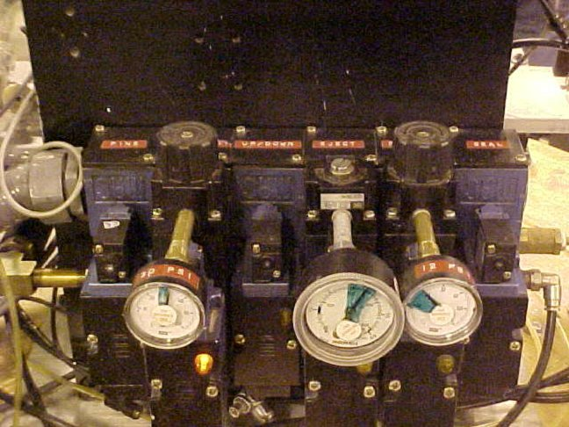
Visual Ranges Make It Easier to Sustain

Slide 52
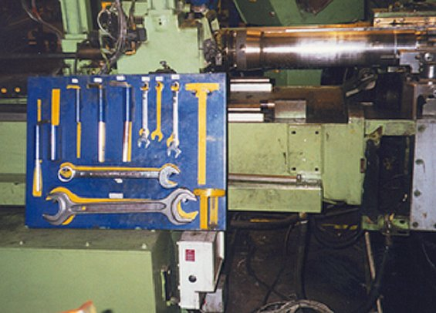
Sustain
Everyone needs to do their part to keep things where and how they belong

Slide 53
5S’S
Sort
X - Tag
Keep what is needed
Stabilize
A place for everything
Everything in its place
Shine
Cleaning is inspection
Standardize
Rules for the first 3 S’s
Sustain
Make it habit
Cooperation

Slide 54
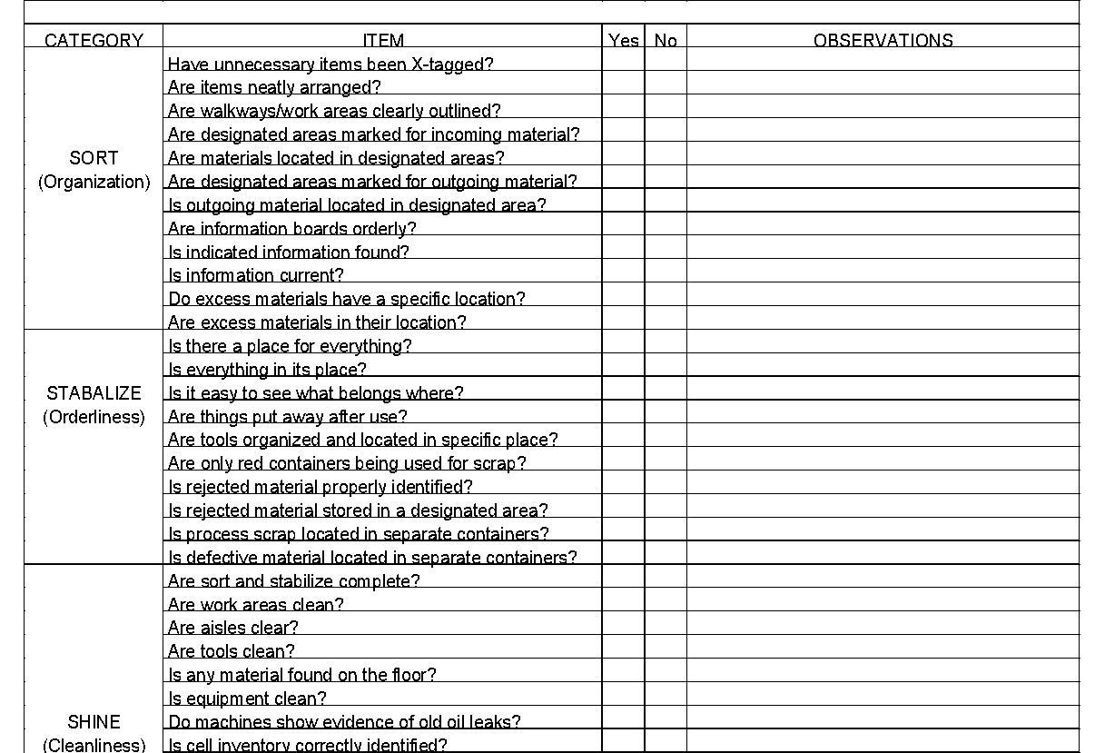
5S Checklist

Slide 55
5S Checklist
5S Audit
7
Audits performed for 5S’s
Visual display of current standings and progress
Emphasis on Sustaining
Points Needing Attention

Slide 56
5S Supportive Strategies
Color coding
Point of use
Safety

Slide 57

Color Coding
Color coding things is a fast, easy way to separate different items and to visually determine if something is misplaced

Slide 58
Scrap
- Manufacturing scrap
- Tubing
- Mixed scrap-banding,
cold rolled, stainless
- Process scrap

Slide 59
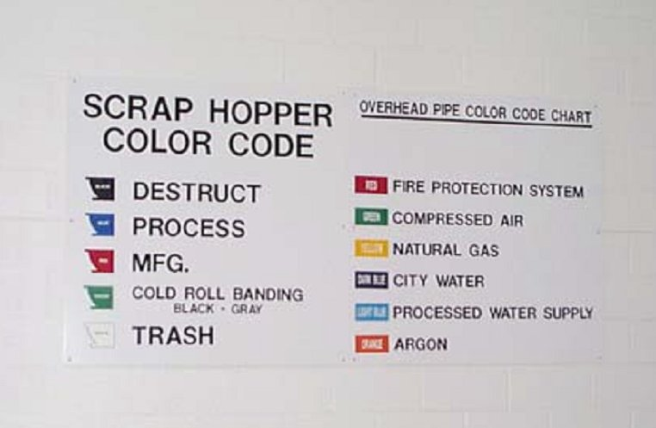
Examples

Slide 60
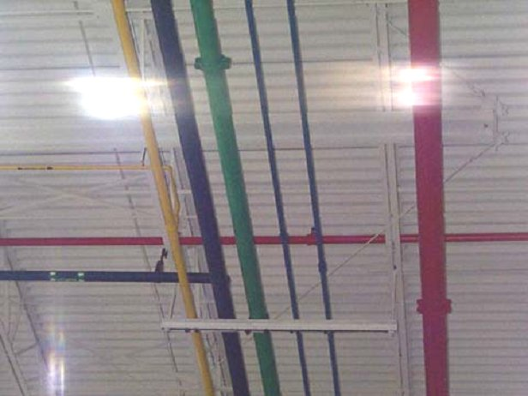
Examples

Slide 61
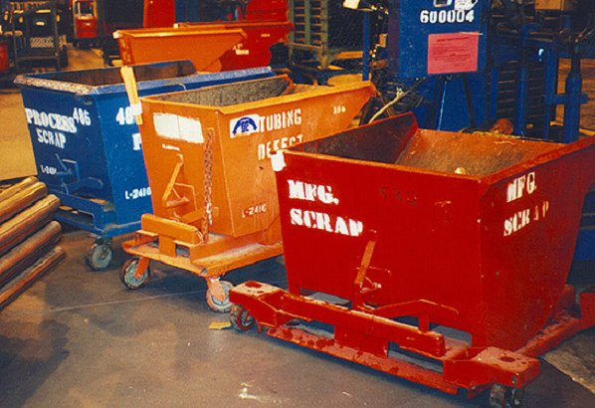
Color Coded Scrap Hoppers

Slide 62
Part Color Coding
Different color for each part number
Colors correspond to colors of:
work units
tooling
gages
fixtures
settings

Slide 63
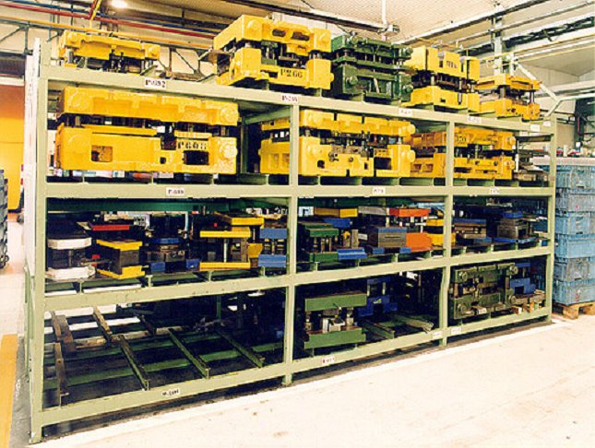
Color Coded Dies

Slide 64
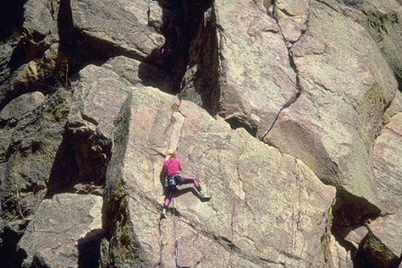
Point of Use
Tools
Parts disposal
Operating procedures
Lock-out instructions
Materials/Finished goods
Information
Looking For Tools

Slide 65
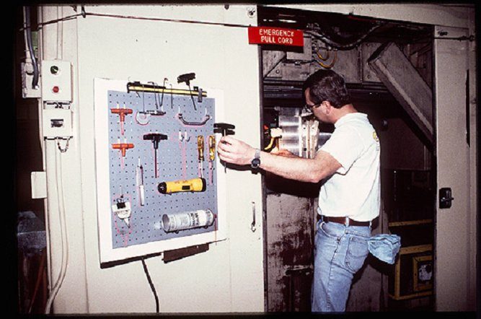
Point of Use

Slide 66
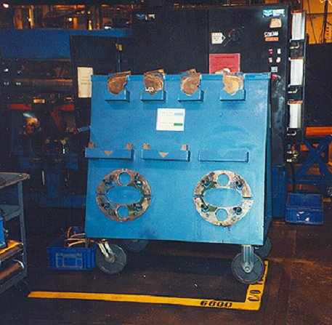
Point of Use
Not enough room to store at the point of use, so make them mobile

Slide 67
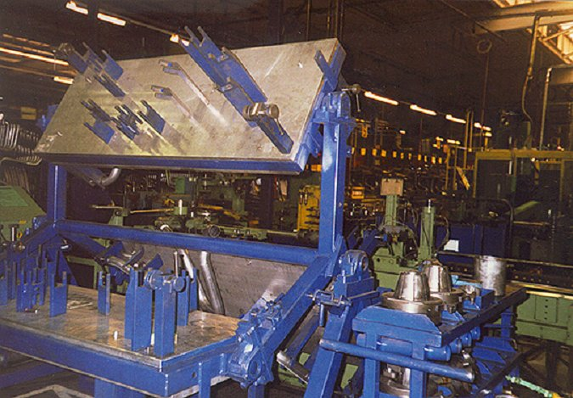
Point of Use
Fixtures rotate so they take up less space and are kept at the point of use

Slide 68
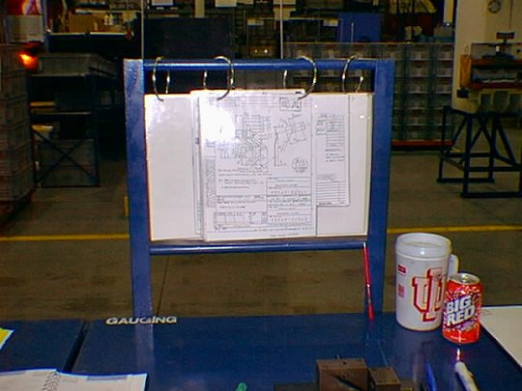
Point of use
Information

Slide 69
Safety: The 6th - S
Is of great concern when considering workplace organization and the 5S’s

Slide 70
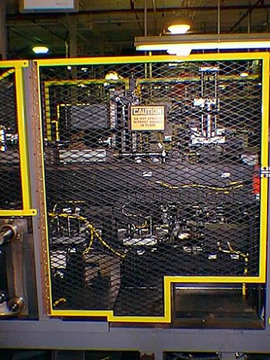
Safety
Color coded guards and labeling

Slide 71
Sufficient Room to Exit the Work Unit
Exit
One small exit for up to 9 operators

Slide 72
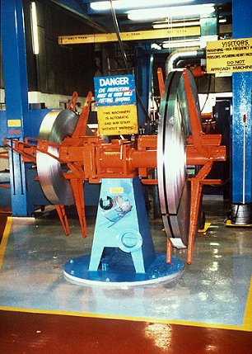
Safety
Well labeled, but what keeps people out of coils?

Slide 73
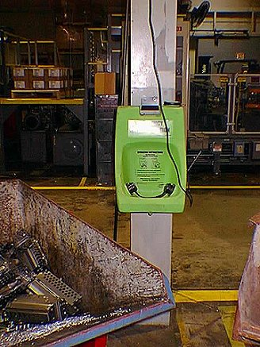
Safety
Color coded and visual
-easily accessible?

Slide 74
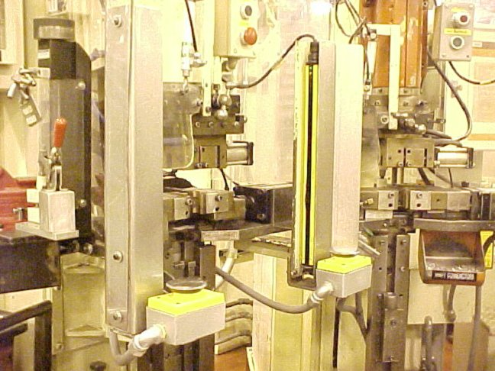
Safety

Slide 75
WPO Exercise
5S and WPO checklist
X - Tag

Slide 76
X-Tag
Name:
Date: Removal Date
Location:
Reason for X-Tag:

Slide 77
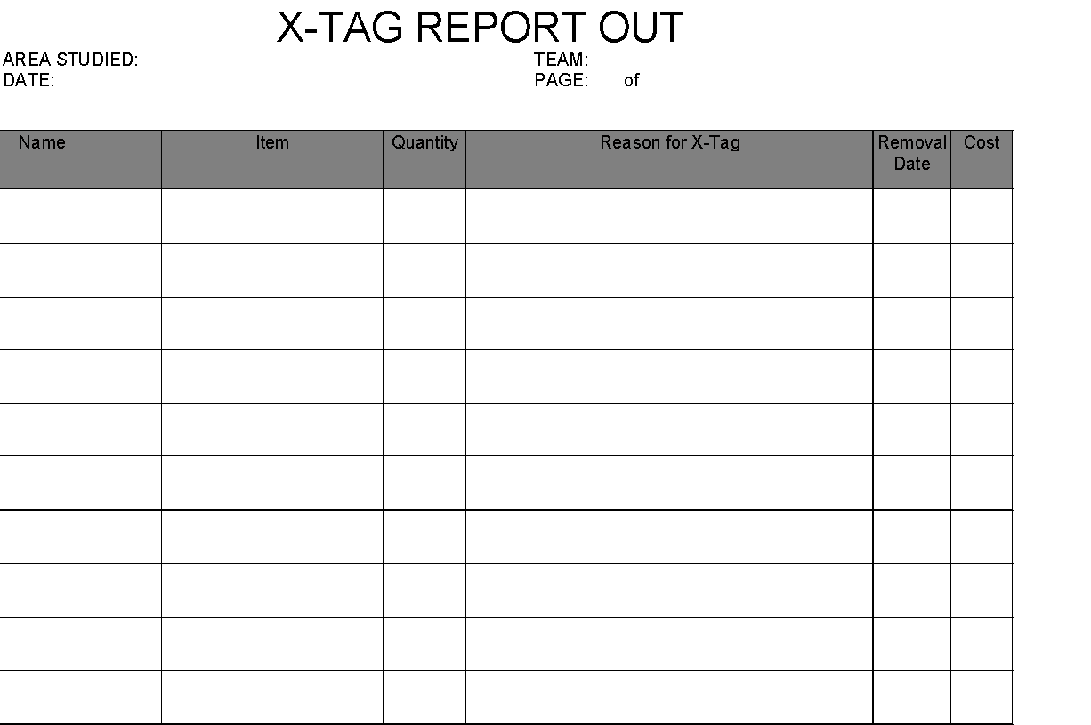

Slide 78
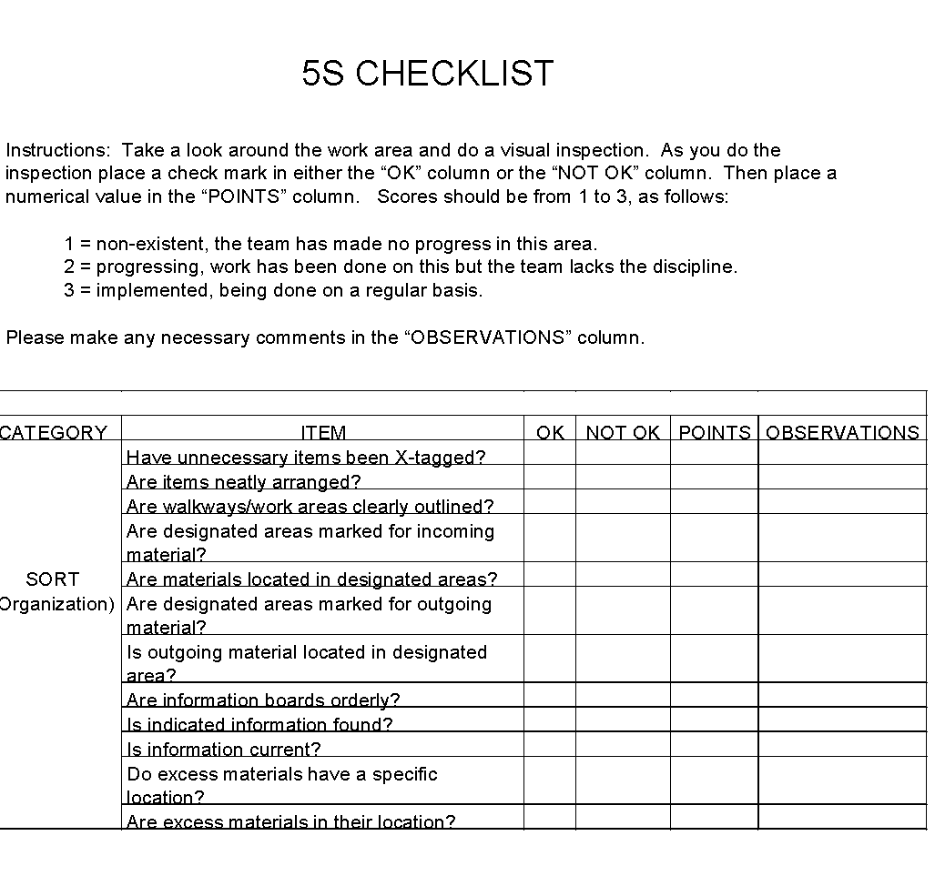

Slide 79
5S Audit
Points Needing Attention

Slide 80
Module 3

Slide 81

Phase 2 of Visual Management is …

Slide 82
How do we create Visual Management?
One phase at a time...
The 2nd Phase is
Visual Display
The 1st Phase is
Workplace Organization

Slide 83
Are we ready for Visual Display ?
Before Visual Display... Implement
5 S

Slide 84
Phase 2: Visual Display
Definition:
A method to visually communicate important information in the workplace
Information regarding:
Safety
Quality
Operations
Equipment
Work Environment
Progress / Achievements

Slide 85
Benefits of Visual Display
Makes work safer and easier
Communicates information about performance
Makes standards visible
Makes problems recognizable
Creates a shared knowledge base

Slide 86
Visual Display tells others…
what is important to our company.

Slide 87
Types of Visual Display
Begin implementing Visual Display with:
Designated Locations
Indicate danger; Set limits; Make work easier
Information Boards
Work Instructions
Checklists

Slide 88

Start with Designated Locations
Designated Locations:
Indicate danger
Set limits
Tell us what, where, and how many
Designated Locations are the first type of Visual Display to be implemented

Slide 89
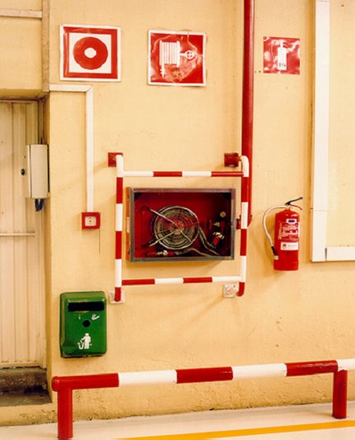
Designated Location Example
This location is
exclusively for
fire safety

Slide 90
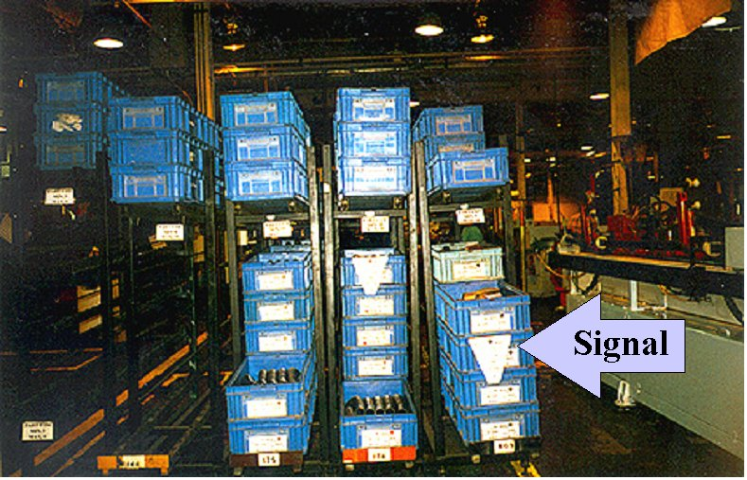
Designated Location Example
Components Kanban: What, Where, and How many

Slide 91
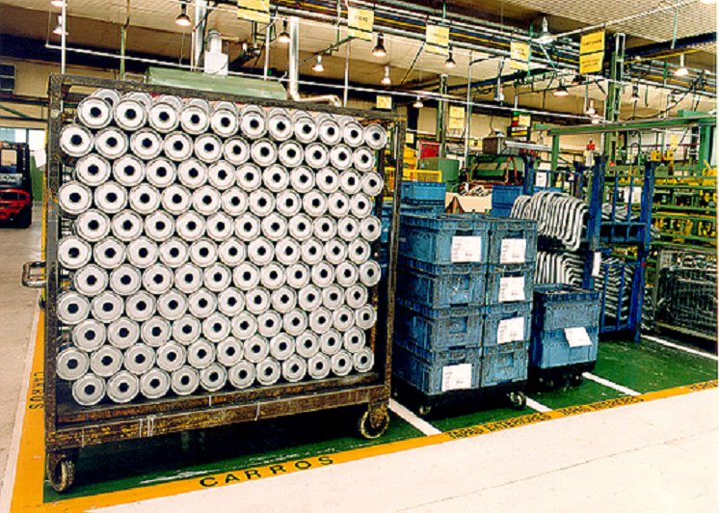
Floor Labeling Example

Slide 92
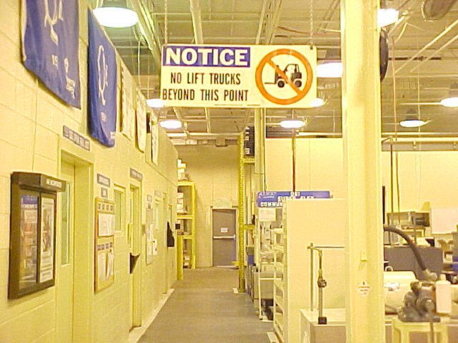
Designated Location Example

Slide 93
Would you pay for a dozen eggs ?
Eggs Grade A

Slide 94
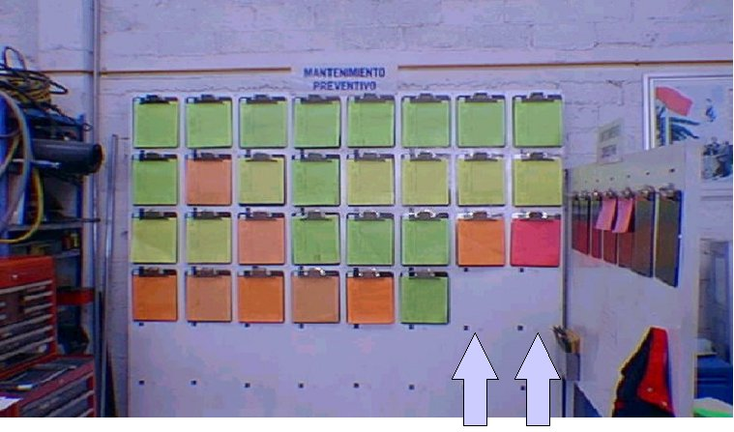
Designated Location Example
Egg Carton Display

Slide 95
Designated Location Guidelines
Determine appropriate location for all needed items
Designate locations for type and correct number (quantity) of needed items
Post visual indicators
Create ways to recognize at-a-glance when items are out of place

Slide 96
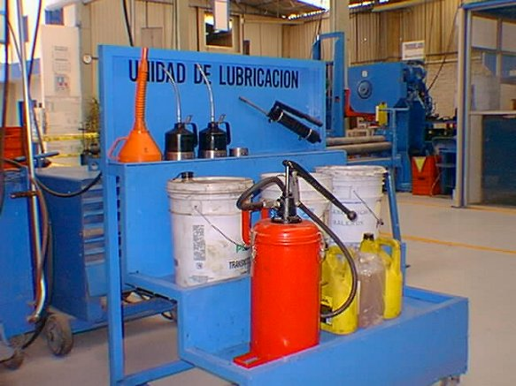
Mobile cart provides designated location and point of use flexibility
Could this idea
make work
easier for anyone
in your plant ?

Slide 97
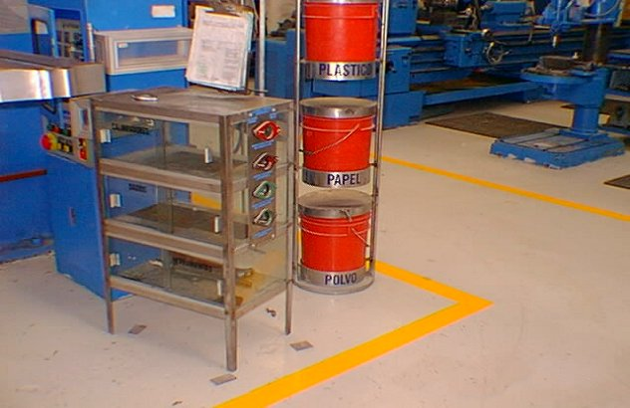
Make Visual Display easy, convenient, manageable

Slide 98
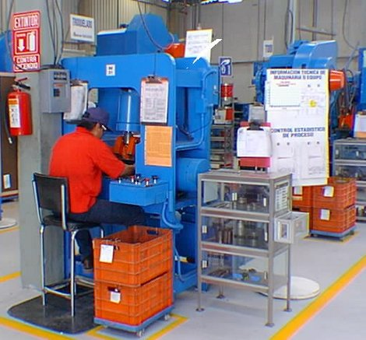
Other types of Visual Display
Work Instructions
Information Board
T P M Checklist

Slide 99
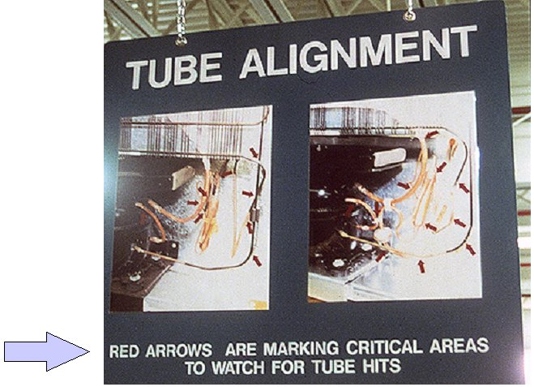
Visual Work Instructions
What do size and placement of work instructions tell us ?

Slide 100
Product Boundary Sample Display
Increases quality awareness
Reduces variation
Useful training aid
Creates pride in products made
Need a new example of
Boundary Sample!!!!

Slide 101
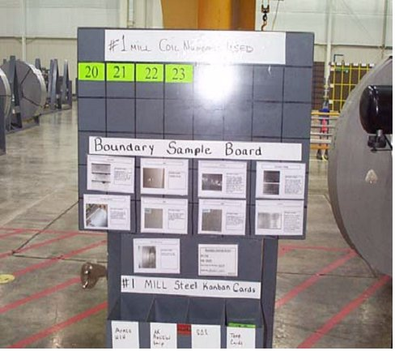
Raw Material Boundary Samples
Set quality standards
Operators make quality decisions
Create shared product knowledge
Use photos when actual samples are not practical

Slide 102
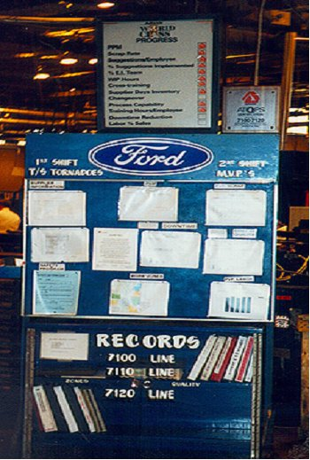
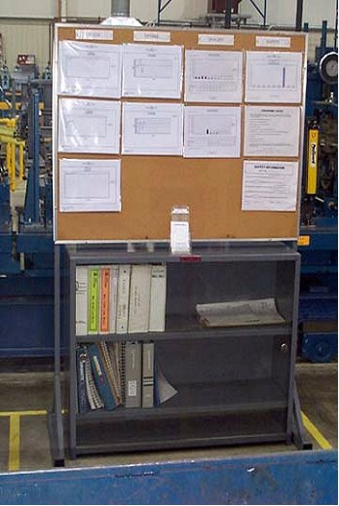
Information Board Examples

Slide 103

Information Boards
What is the focus of this information board ?

Slide 104
20 Keys of Continuous Improvement
Current
Work Unit
Goal
Problem Solving & Avoidance
Skill Versatility & Cross-Training
Process Capability & Control
Quality Assurance Approach
Environmental Management
Team Meetings & Activities
Management of Objectives
Management at a Glance
Coupled Manufacturing
Employee Commitment
Preventive Maintenance
Production Scheduling
Supplier Development
Delivery Performance
Cleaning -Organizing
Knowledge Utilization
Quick Changeover
Work Standards
Quality System
Safety
5
B E S T I N C L A S S
5
4
W O R L D C L A S S
4
Performance Level
Performance Level
3
L E A D I N G
3
2
L E A R N I N G
2
1
T R A D I T I O N A L
1
1
2
3
4
5
6
7
8
9
10
11
12
13
14
15
16
17
18
19
20

Slide 105
Safety/Health
Leadership
Vision & Executive Sponsorship
Objectives/Improvement Planning
Communication
Learning & Personal Skills Development
Managing Change
Team Building / Teamwork
Problem Avoidance
Idea Implementation
New Product/Process Introductions
Internal Customer Focus
Team Recognition
External Customer Focus
Supplier Development
C I Tool Utilization
People Supportive Practices
Valuing Continuous Improvement
Environment
Best Place To Work
20 Keys of Site Excellence
Current
Goal
5
4
3
2
1
5
4
3
2
1
BEST IN CLASS
W O R L D - C L A S S
Performance Level
L E A D I N G
Performance Level
L E A R N I N G
T R A D I T I O N A L
1
2
3
4
5
6
7
8
9
10
11
12
13
14
15
16
17
18
19
20
11-8

Slide 106
Information Board Guidelines
Work Unit determines what will be displayed
Make information easy to read and understand
Always post information in same location
Keep the focus clear; don’t overload info
Keep information current

Slide 107

Other Types of Visual Display
Status Boards
Product Displays
Storyboards / Pictures
Electronic Marquees
Business Unit Display

Slide 108

The best visual displays are easy to understand
Symbols
are easily understood
give immediate status
engage viewer’s attention

Slide 109

Symbols make status visible and easy to understand
What other information might be useful here ?

Slide 110

Pictures Display Before and After
Improvements are easily documented with pictures

Slide 111


TPM Before and After ( Storyboards )

Slide 112

To add impact
to visual displays,
relate items to
a cost.

Slide 113

Product display for waste awareness

Slide 114

Using Visual Display to show operating supplies cost

Slide 115

Product Display Example
Display used as a problem-solving tool
Sample assembliesare added to display
every 2 hours

Slide 116

Team decision-making tools
How do balance boards and cross training charts become team decision making tools ?

Slide 117

Cross Training Chart

Slide 118

Everyone knows, “Safety is our Top Priority”

Slide 119

Lost Time Accidents
Goal is “Zero Accidents”
Always keep displays up to date
Changing the display daily focuses our attention on safety -daily

Slide 120

Lighted displays capture attention
What audio warnings exist for safety concerns?

Slide 121

These standard lighted displays provide …
Consistency
Easy visibility
Status at a glance
Problem recognition
Team encouragement

Slide 122

Marquee Information Display
What are other good uses for marquee displays ?

Slide 123

Visual Displays as As Voice to our Visitors
Share success stories
Recognize team achievements
Communicate pride in our work

Slide 124

Team Territory
This area is the team’s domain, but it is seen by all

Slide 125

Team Territory is a place to ...
hold shift startup meetings
identify the team
exhibit products made
be managed by the team
communicate team goals
display team accomplishments

Slide 126
Shift Start-Up Meetings
A daily working session at the start-up of the shift that’s:
Short, every day, each shift and in each work unit
A consistent method to communicate essential information
A way to accelerate the dissemination of essential information
A daily discipline that helps improve team performance daily
An opportunity to refer to and update the Primary Visual Display
A essential tool to help create & maintain team involvement
Daily shift start-up meetings are the place to communicate and share news and information.

Slide 127
Shift Start-Up Meetings
The meeting is short and very focused
10 minutes maximum
Centered on daily issues and activities
Meeting held with entire team and facing the Primary Visual Display
Participants stand during the meeting
Team members take turns being the facilitator
Initially this is led by supervision
Note: Could be up to a month until the team is confident with what to do and natural leadership begins to emerge – still, it’s important to give everyone an opportunity to facilitate the meeting and supervision often continues to participate to offer support, help remove obstacle and roadblocks and stay in tune with issues.
Team records decisions, actions & next steps on Primary Visual Display
No formal/Computerized report writing desirable or necessary
Other discussions should happen outside this meeting

Slide 128


Provide teams the territory they need to succeed
Common Territory
Shared Territory

Slide 129

Extra ! Extra ! Extra !
Plant newspapers provide excellent opportunities
for recognition of
employees !

Slide 130
Customer / Supplier Information
What do we produce?
What is it used for / on?
Who do we contact if we have problems?
Who supplies our materials?
Where do our finished goods go?

Slide 131

Customer / Supplier Display
What is being produced here?
Where is the product used?

Slide 132

Exhaust assembly display with vehicle application

Slide 133
How to implement Visual Display
Identify subject to focus on
Identify problems or success associated with the subject
Identify the audience for visual display
Choose the best location for the display
Develop and test the display
Improve, finalize, and implement the display

Slide 134
Review: Does your visual display offer these benefits?
Communicate information about performance
Make standards visible
Makes problems recognizable
Make work safer and easier
Recognize an achievement
Creates a shared knowledge base

Slide 135
Remember... Your Visual Displays tell others...
what is important to ourcompany!

Slide 136

Visual Management
Module 4

Slide 137

Phase 3 of Visual Management is …

Slide 138
How do we create Visual Management?
One phase at a time...
The 3rd Phase is
Visual Measures
The 2nd Phase is
Visual Display
The 1st Phase is
Workplace Organization

Slide 139
Visual Measures
In this module we will discuss:
Using the data we collect
Seeing is believing
Measurement tools
Effective data display
BOS Charting
How to develop meaningful measures

Slide 140
Why do we use measurement data?
To make more informed decisions about our operations
To keep management and shop floor associates informed of progress
To drive and fine-tune our improvement activities
To educate the plant community
If you are not going to use data, don’t collect it!

Slide 141
Seeing is believing !
I should have
implemented
this idea sooner!
Effective analysis requires effective reporting
How we report and display data will affect how we think about it

Slide 142
Lasting Impressions
To increase the impact of information:
Make it sensory; use pictures, charts, sample products, and audio sounds that involve the audience
Use examples and comparisons
Make data speak; keep it visually appealing
Don’t forget, “Keep it simple”

Slide 143
To make data displays effective...
Involve users in the measurement
Provide the results to people who can act on them
Present results in the most appropriate form for the audience
Link results with improvement activities
Report data immediately; date it; keep it current

Slide 144
What do we measure ?
Cross
Training
P P M
Process
Capability
Lost
Time
Accidents
Uptime /
Downtime
Floor Space
Supplier
Quality
Changeover
Time
Manufacturing
Scrap

Slide 145
The Standards
Company recommends these standard measurement
tools be used to:
Indicate status
Collect data
Solve problems
Measure performance

Slide 146
Company Standard Measurement Tools and Indicators
Changeover Clock
Production Counters
Error Proof Symbols
P.I. Indicator
Lost Time Accidents
5 S Audit
Downtime Clock
Process Capability Logo
Bottleneck Symbols
Current Part Running
Limbo Bars
BOS Charts

Slide 147

To increase information value . . .
Insure data accuracy
Put information in graphic form
Place it where the work gets done
Use it often to track improvements
Keep it current

Slide 148

Visual Production Counters
Visual production counters
help us:
Keep accurate counts
Make goals visible
Detect production abnormalities
Satisfy customers
Goal / Actual / + or -

Slide 149

Downtime / Product Count Example

Slide 150

5 S Audit Tools

Slide 151

Is there a visual measure of our Customer Satisfaction ?
Collect customer satisfaction data
Display it where everyone sees it
Keep track of progress
Highlight special achievements / awards

Slide 152

Safety First ! Always.
Make safety records visible
Perform regular safety audits
Display lost time injuries / accidents
Keep track of where, when, why, and how accidents occur

Slide 153





The Versatile BOS Chart
The BOS Chart can wear
many hats:
Visual display
Problem solving tool
Progress indicator
Assign responsibilities

Slide 154
Follow these steps to use BOS for Visual Measures
The best reason to include BOS Charting with measure displays is because BOS requires action !
Key Measurable
Improvement
Activities
Data Analysis
Improvement
Tracking

Slide 155

BOS Key Measurable
LINE:________________
DATE:_______________
TREND LINE
SUGGESTIONS
Ref #
Suggestions
Resp
Comp
Date
%Comp
25
50
75
100
25
50
75
100
25
50
75
100
25
50
75
100
25
50
75
100
25
50
75
100
25
50
75
100
25
50
75
100
Ref #
Description
ANALYSIS (PARETO)
IMPROVEMENT TRACKING

Slide 156
Step 1 Involve users in the measurement
Team members collect data; track numbers:
Total product produced
per hour, per shift, per day, per week, etc.
Average time to produce one unit
PPM - number of defects
Scrap - percentage of total produced
Changeover time
Downtime / Uptime

Slide 157

Step 2 Team determines what to BOS Chart
Something needing improvement
Team has control
Important to customer
Important to our company

Slide 158

Step 3 Team members update BOS
Use team meeting to study data
Team plans improvement activities
Everyone participates
Computers not required

Slide 159

Step 4 Make BOS results visible at the Work Unit

Slide 160
To develop Visual Measures decide . . .
What needs to be measured ?
Who is the user / audience ?
How often do we take the data ?
Who will do the tracking ?
How will we display data so that it speaks ?
Where do we best locate the display ?

Slide 161
Reality Check for Measures
Answer these four questions about the measures you use:
Are they simple and easy to use?
Do they change over time?
Do they provide rapid feedback?
Do they foster continuous improvement?

Slide 162


Slide 163

Module 5

Slide 164
How do we create Visual Management?
One phase at a time...
The 4th Phase is
Visual Management
The 3rd Phase is
Visual Measures
The 2nd Phase is
Visual Display
The 1st Phase is
Workplace Organization

Slide 165
Visual Management
Using the information provided by visuals to make informed and proper decisions or judgements daily.

Slide 166
Vision
The Visually Managed Factory is:
A workplace that is easily understood by all. Anyone could walk into a work unit and at a ‘glance’ understand the status of that work unit, what is waste or abnormal, and where improvements are needed.

Slide 167
Vision
If you walked into a work unit or facility on Sunday.
No one is around and nothing is running. Would you be able to understand the status of that work unit?

Slide 168
Visual Management
Status
Distinguish between what is and is not normal
Make waste and abnormalities obvious to everyone
Constantly uncover needs for improvement
Help make each persons job easier
Involve everyone

Slide 169
Status at a Glance
What information do we need to know?
Is it?
easily visible
consistent throughout the facility or business unit
current
USEFUL

Slide 170
Visual Management For:
Workplace
Safety
Operations
Equipment
Quality
Storage

Slide 171
Status at a Glance
What do certain visuals communicate and how do we use them to manage?
Production counters
Downtime/Uptime clocks
Change-over clocks
BOS charts

Slide 172
Status at a Glance
What do certain visuals communicate and how do we use them to manage?
Safety
PPM
Scrap

Slide 173
Visual Management
The following are some examples of these visuals or measures.
What do they communicate to us?
How do they communicate it?
What judgements or decisions do they help us to make?

Slide 174

Examples

Slide 175

Examples

Slide 176

Examples

Slide 177

Examples

Slide 178

Examples

Slide 179

Examples

Slide 180

Examples

Slide 181
Needs for Improvement
Knowing very little about these facilities,
with the simple visuals we just looked at,
we were able to make some suggestions
for possible improvements.

Slide 182
Needs for Improvement
Utilize these visuals to make improvements and suggestions for improvements during:
EI meetings
Shift Start Up Meetings
Downtime
ALL the Time

Slide 183
Standard Work Tools
Balance boards and equipment layouts are used to:
Level work loads
Make our jobs easier
Processes better and more efficient

Slide 184

Standard Work Tools
What does this tell us?
How would you use this to manage?

Slide 185
Cross Training Chart
25%
50%
75%
100%
Able to process
Able to process
Able to process
Able to train others
w/ direction
w/o direction
& problem solve
on entire process
Inter-Plant Transfers (On-Line)
Skills Assessment
Plant Material Inventory
Radio Frequency (RF)
Hazardous Mat’l Inventory
Kanban/Single Scan
Inventory Receiving
Trakker Scanner (IRL)
Plant Batch Reporting
Inventory Bar Code
Division Item
Employee Name
Joe
Bob
Betty

Slide 186
Designated Areas of Responsibility
Color coded maps
Who does what?
How often do they do it?

Slide 187
Red Box Scrap
Separates non-conforming materials from product flow
Gives a definite point for stopping the line and taking corrective action
Promotes visual awareness of repetitive defects

Slide 188
Red Box Scrap
Are there less than 6 total or 3 identical parts in the box?
YES - continue production
NO - stop production and take corrective actions

Slide 189

Control Ranges

Slide 190
Error Proofing Program
P1 Device
(Green)
An Error Proofing device that PREVENTS an error from occurring

Slide 191
Error Proofing Program
P2 Device
(Purple)
An Error Proofing device that DETECTS an error in time to allow rework and prevents further errors of the same type

Slide 192
Error Proofing Program (POKA YOKE)
P3 Device
(Blue)
An Error Proofing device that detects a defect and ELIMINATES IT FROM THE FLOW of good products

Slide 193


Visual Management
Are WE Hitting the Target?

Slide 194
Do Our Visuals:
Give you the information needed to make proper decisions?
Make abnormalities and problems obvious?
Promote communication and employee involvement?
Make everyone's jobs easier?
Recognize achievements and improvements?

Slide 195
The Visual Management Check List and Implementation

Slide 196


Slide 197


Slide 198
End of Visual Management

